Slide 1

Partitions and Linux System Logs
Prepared by : Abanoub Asaad

Slide 2
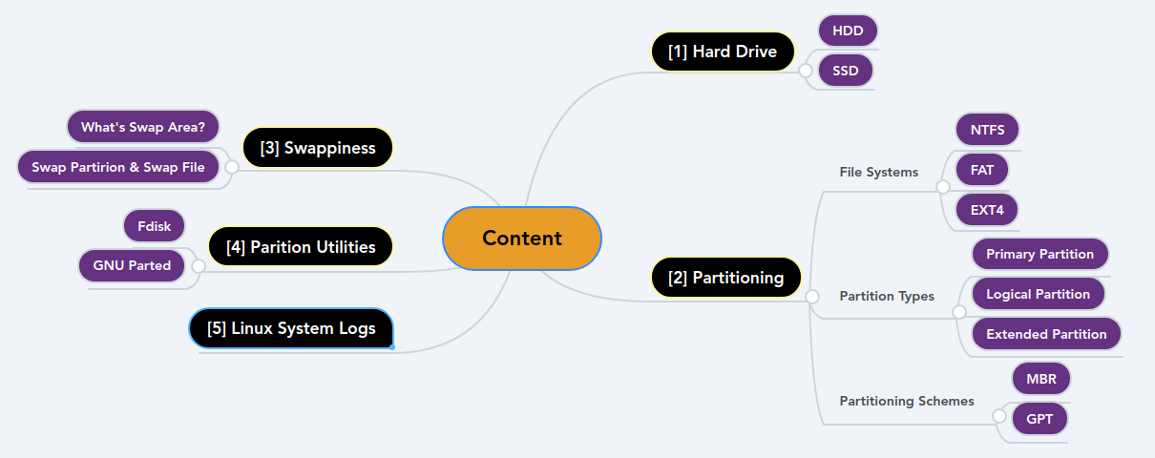
Content

Slide 3
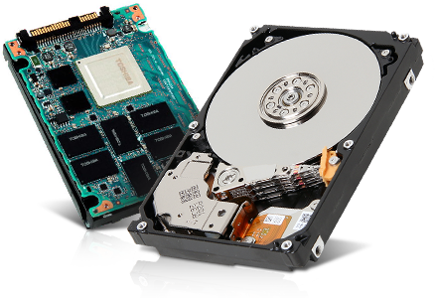
Hard Drive
- It is a Non Volatile Storage
- There’s 2 types of Hard Drive :
1- HDD
2- SSD

Slide 4
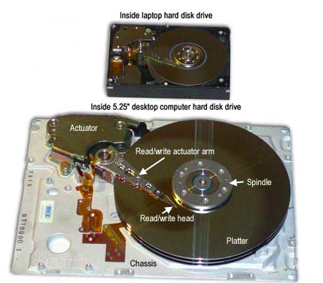
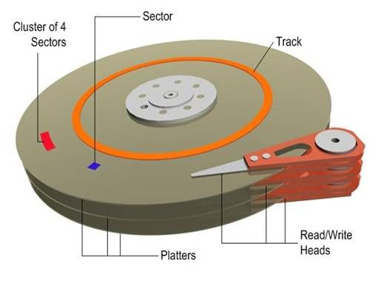
1- HDD (Hard Disk Drive)
– Components

Slide 5
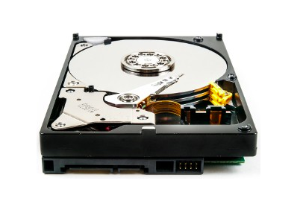
How data is stored in HDD ?
- We’re all know that data is stored with 0’s or 1’s
SO How data is stored in the Hard Drive ?
Using Magnets

Slide 6
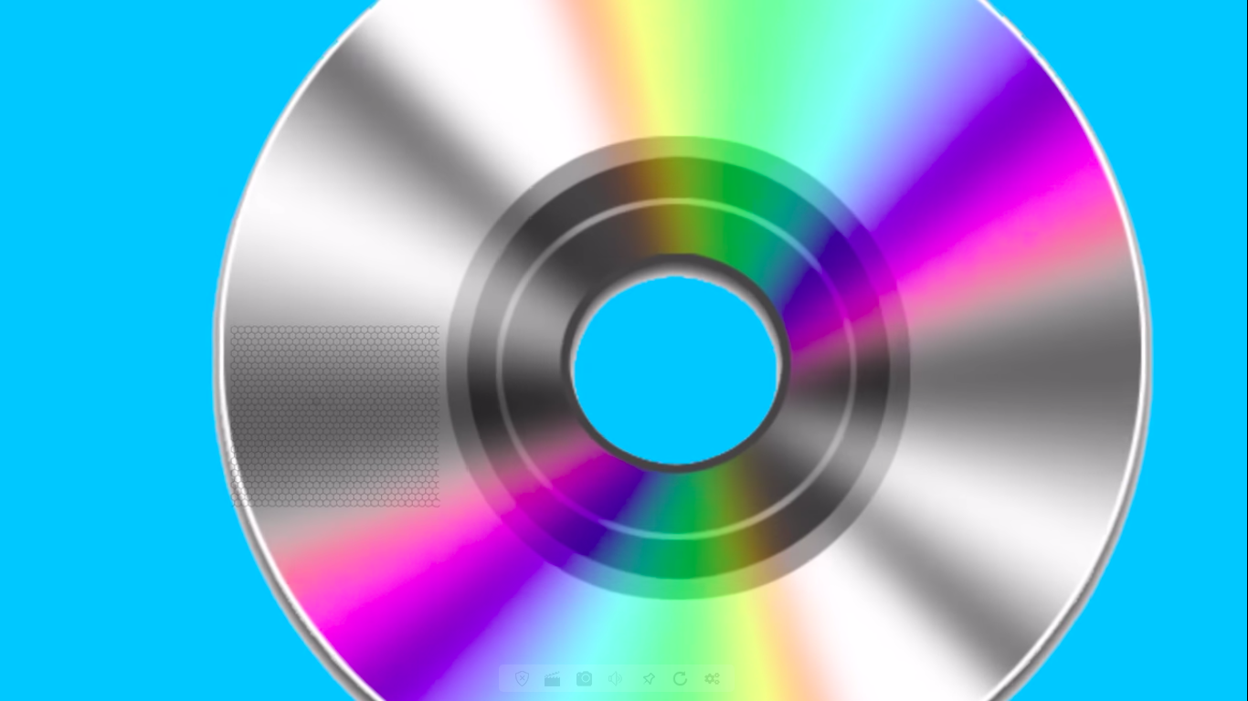

The platter (disk) contains ferromagnetic material

Slide 7
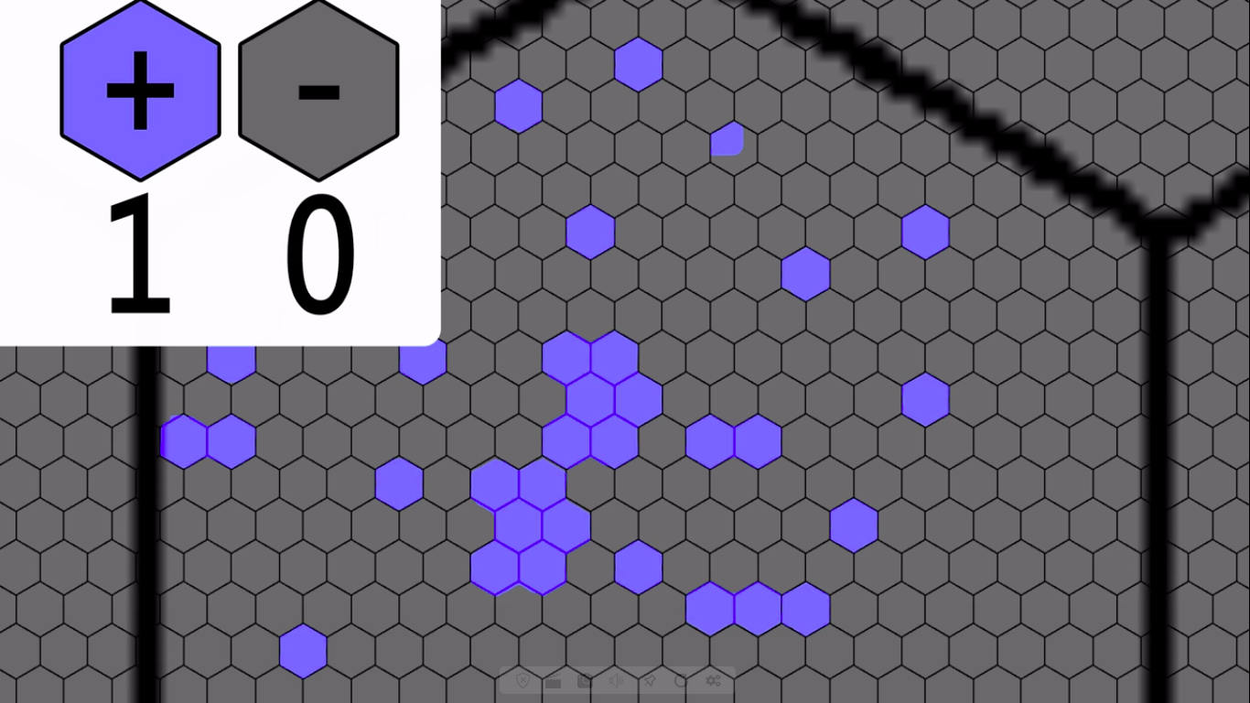
- Single region represents a single digit of binary
- Actuator arm : sends magnetic charges to the disk

Slide 8
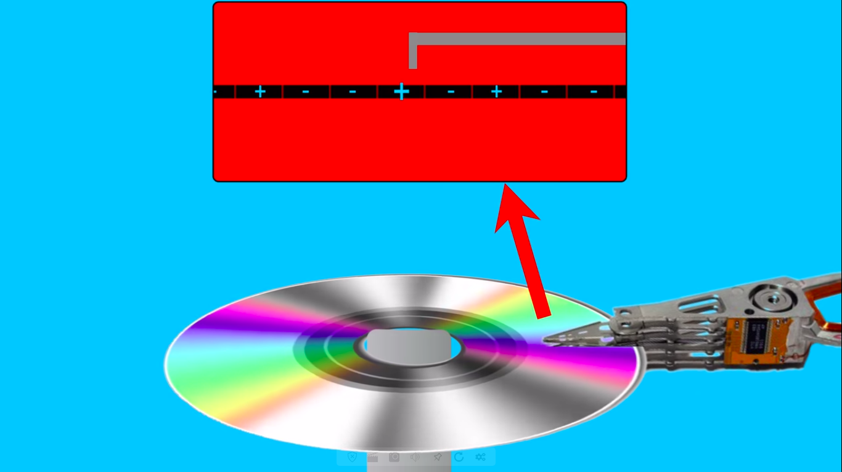
There’s two methods what deals with data :
1- Writing Data
2- Reading Data.

Slide 9
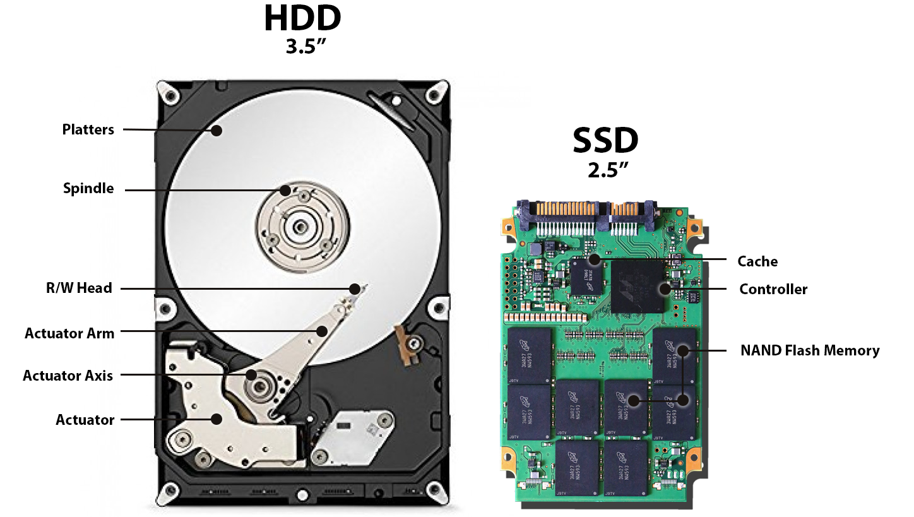
2- SSD (Solid State Drive)
- Components
1- Cache
2- Controller
3- NAND Flash Memory
SSD has no moving parts

Slide 10
Interactive Question
Why Photoshop speed in SSD is faster than HDD ?!

Slide 11
Content

Slide 12
Partitioning
A hard disk can be divided into several partitions.
Advantages of Partitioning :
1- Organizing personal data
2- Multiple operating systems
3- More efficient disk space management.

Slide 13
File System
Definition : is a process that manages how data is stored or accessed in the hard drive.
Types :
FAT12, FAT16 & FAT32
NTFS
ExFAT
Ext2, Ext3 & Ext4
HFS, HFS+ & APFS
Linux-Swap will be explained later :)

Slide 14
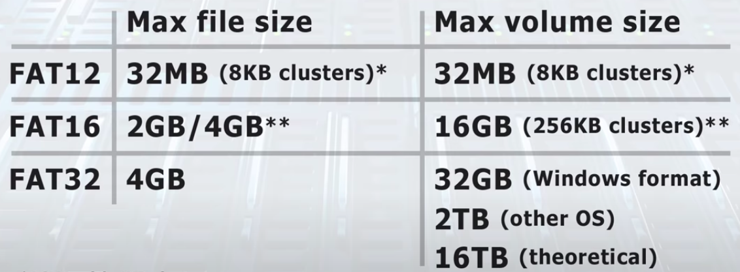
– FAT12, FAT16 & FAT32
FAT “File Allocation Table”
Each has an increasing number of clusters, maximum file and volume sizes.
FAT32 is the most popular one and so suitable for flash drive.

Slide 15
– NTFS
NTFS “New Technology File System”
It’s introduced in 1993 to overcome the limitations of FAT32
It’s the most popular windows file system
Unlike FAT32, NTFS supports permissions and encryption.
Disadvantages :
By default NTFS volumes are read-only in Mac OS and in older Linux distros.

Slide 16
– ExFAT
ExFAT “Extended File Allocation Table”
It’s a file system introduced by Microsoft
It’s optimized for flash memory such as USB and SD cards that larger than 32 GB.

Slide 17
– EXT2, EXT3 & EXT4
In 1992, ext “extended file system” was launched for Linux
In 1993, ext2 was released
In 2001, ext3 was released
In 2008, ext4 became the Linux default FS.
Disadvantages :
Neither Windows or Mac OS supports ext2, ext3 or ext4.

Slide 18
– HFS, HFS+ & APFS
In 1985, HFS “Hierarchical File System” was launched for Mac OS
In 1998, HFS+ was released
In 2017, APFS “Apple File System” is launched
Disadvantages :
Neither Windows nor Linux supports HFS, HFS+ or APFS.

Slide 19
Interactive Question
In the current time , What’s the suitable file system to use in Windows, Linux, Mac OS and USB drivers ?!

Slide 20
– Partition Types
Primary Partition
is the partition where Windows OS and other data can be stored. You can only boot from a primary partition
Logical Partition
is the partition that can any other data that not related to the boot
Extended Partition
is a special type of primary partition but is created by a different way.
((Conversion))

Slide 21
– Partitioning Schemes
MBR | GPT
Stands for “Master Boot Record” | Stands for “GUID Partition Table”
Can contain up to 4 primary partitions | Can contain up to 128 primary partitions
Can access up to 2 Terabyte | Can access more than 2 Terabyte “has no limit”
Used with Old BIOS (Legacy Boot) & UEFI sometimes | Used with UEFI
GPT is the most preferred partitioning schemes for hard disks.
((Conversion))

Slide 22
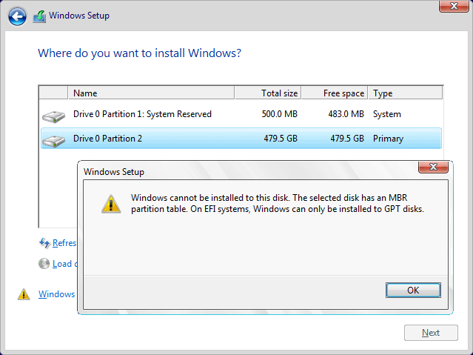
Interactive Question
Have anyone faced this problem ?
How to solve it ?

Slide 24
– Swappiness
is a technique where data in RAM is written to a special location on your hard disk - either a swap partition or a swap file to free up RAM.
Swap area is the extension of the RAM
Swap Space :
Swap Partition :
is not easy to change and has fixed size
Swap File
You can change the size of the file any time easily.

Slide 25
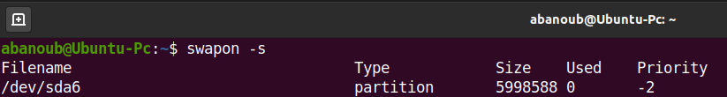
Advantages :
Swappiness saves you from crashes
Disadvantages :
Swap space is much slower than RAM
To display information about the swap partition

Slide 26
– What is the right amount of swap space?
Amount of system RAM | Recommended swap space
less than 2 GB | 2 times the amount of RAM
2 GB - 8 GB | Equal to the amount of RAM
8 GB - 64 GB | 0.5 times the amount of RAM
Let’s continue :)

Slide 28
– Partition Utilities
are used as a software to manage the hard disk and its partitions
are like Disk Management in Windows
Types :
Fdisk
GNU Parted

Slide 29
1 - Fdisk
It is a simple text-based partitioning utility
It exists for both Windows and Linux
You can use the fdisk utility in Linux to view, create, modify or edit partitions
To use fdisk in Linux :
Be a super user
Type this command : fdisk /dev/sda

Slide 30
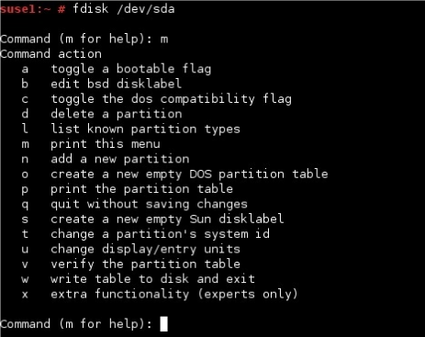
Screenshot of fdisk in Linux

Slide 31
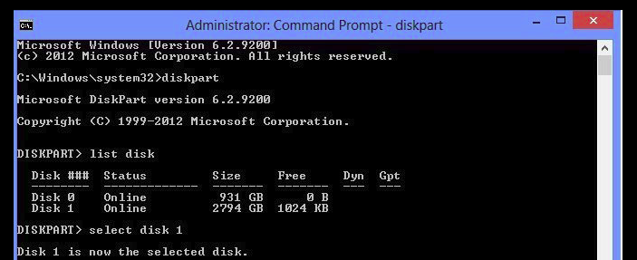
Running fdisk in Windows
1- Run cmd as an administrator
2- type this command : diskpart

Slide 32
2 – GNU Parted
It is a simple text-based partitioning utility
It’s a text-based partitioning utility manages the hard
disk
There’s a GUI-version of that software
To use GNU Parted in Linux :
Be a super user
Type this command : parted /dev/sda

Slide 33
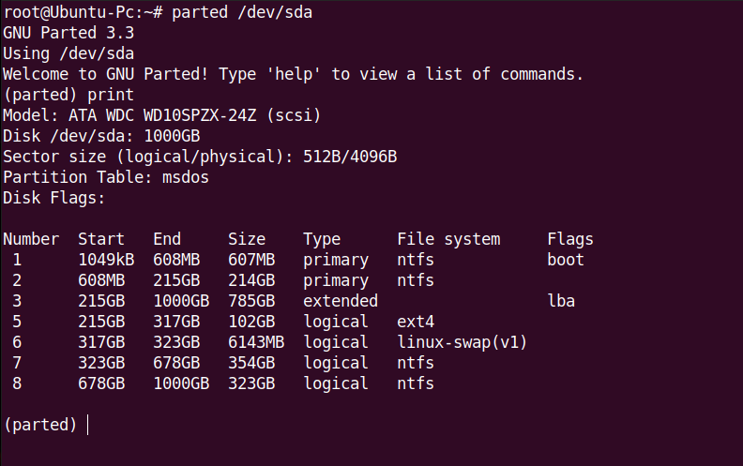
Screenshot of
GNU Parted in Linux

Slide 34
Parted | Fdisk, Sfdisk
Create GPT partition table | Create DOS partition table (MBR)
Address up to 8ZB | Format up to 2TB -> 16TB
128 partition or more | Only 16 partitions
Two copies of partition table are saved (At the beginning & end of the disk) | Only one copy of partition table is stored
- So Parted is really good to use
- To view partition table :
sudo fdisk -l or sudo parted -l

Slide 36
– Linux System Logs
Log entries are like footprints
A log file : is a file contains entries with information about some past event
Most logs files are in plain text
Most logs files reside in the /var/log directory and the other log files in /var/run
Log analysis is important in Troubleshooting
Troubleshooting is a form of problem solving

Slide 37
– Log Files
Path | Importance
/var/log/messages In some distros /var/log/syslog | Shows messages related to the system
/var/log/dmesg | Shows messages from hardware devices and drivers
/var/log/secure | Shows messages related to authentication messages
/var/log/auth.log | Shows messages related to System authorization
/var/log/kern.log | Shows kernel messages
/var/log/cron | This log file records information on cron jobs

Slide 38
– Log Files cont..
Path | Importance
​ /var/log/boot.log | Contains messages generated during the boot
/var/log/daemon.log | Contain messages from processes running in the background
/var/log/apt | record activities of pakcage managers for apt (for Debian and Ubuntu)
/var/log/dpkg.log | record activities of pakcage managers for dpkg
/var/log/yum.log | record activities of pakcage managers for yum (for )
/var/log/wtmp /var/log/btmp /var/run/utmp | Contain login records file

Slide 39
It’s DONE :)

